Slide 1
The City of Adelaide AI Chatbot
Notes:
Good morning, I’m Clayton from Adelaide
How many of you have been to Adelaide in the last twelve months? Hands up please…

Slide 2
Two parts today: A little bit about AI and chatbots Our chatbot experience thus far and a video showcase
Notes:
But we’re not really hear to talk about Adelaide, as much as I love it
We’re here to talk about the future of customer engagement, and my presentation today is about artificial intelligence chatbots
At the City of Adelaide we’ve been trialling a chatbot for about 8 months now.
Two parts today
Firstly, we’ll talk generally about AI and chatbots
And then I’ll show you a video demo of our chatbot and provide some insights about our experience to date

Slide 3
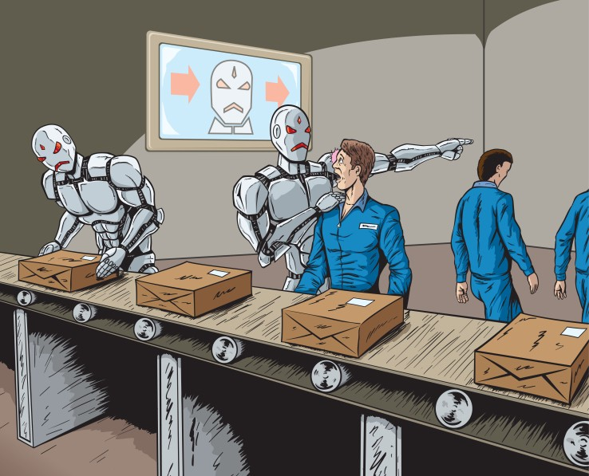
What is AI?
The gradual accumulation of knowledge and power by computers, ultimately enabling them to overpower their human masters, and effect the destruction of the human race.
Notes:
Let’s get our definitions down pat first…
So what is AI?
Well according to Wikipedia, AI is:
the gradual accumulation of knowledge and power by computers, ultimately enabling them to overpower their human masters, and effect the destruction of the human race.
OK, so that’s not the definition for AI at all...but it’s funny how it’s always the first topic of discussion when talking about AI.
We start talking about some dystopian doomsday scenario
where robots control the earth
and we’ve all been enslaved
and we’re forced to work in salt mines with shackles on our legs.

Slide 4
What is AI? (for real)
No agreed definition and it covers a lot of things: machine learning, drones, robotics, virtual reality and big data.
A 1950s definition: Any task performed by a program or a machine that, if a human carried out the same activity, we would say the human had to apply intelligence to accomplish the task*.
Source: Minsky and McCarthy, cited at https://www.zdnet.com/article/what-is-ai-everything-you-need-to-know-about-artificial-intelligence/
Notes:
It’s a little more mundane that that…
The reality is that there’s no agreed definition of what AI is; it encompasses a lot of contemporary technologies: machine learning, drones, robotics, virtual reality and big data all have a part to play in AI.
A definition that was established in the 1950s is probably better than most –
AI is any task performed by a program or a machine that,
if a human carried out the same activity,
we would say the human had to apply intelligence to accomplish the task.
That’s probably as good a definition as any.

Slide 5
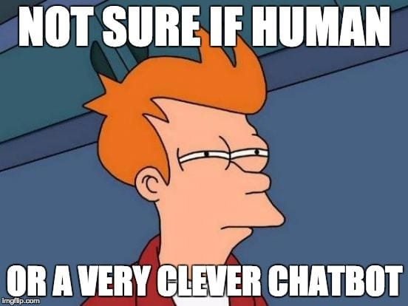
What is a chatbot?
A computer program that interacts with a user through text or audio.
Chatbots provide automated, intelligent responses to requests from customers.
They use machine learning, artificial intelligence (AI) and natural language processing (NLP) to learn from and improve upon past interactions.
Notes:
So, what is a chatbot?
A chatbot is a computer program that interacts with a user through text or audio.
Chatbots provide automated, intelligent responses to enquiries from customers.
Modern chatbots now use machine learning, artificial intelligence and natural language processing (NLP) to learn from -- and improve upon -- past interactions.

Slide 6
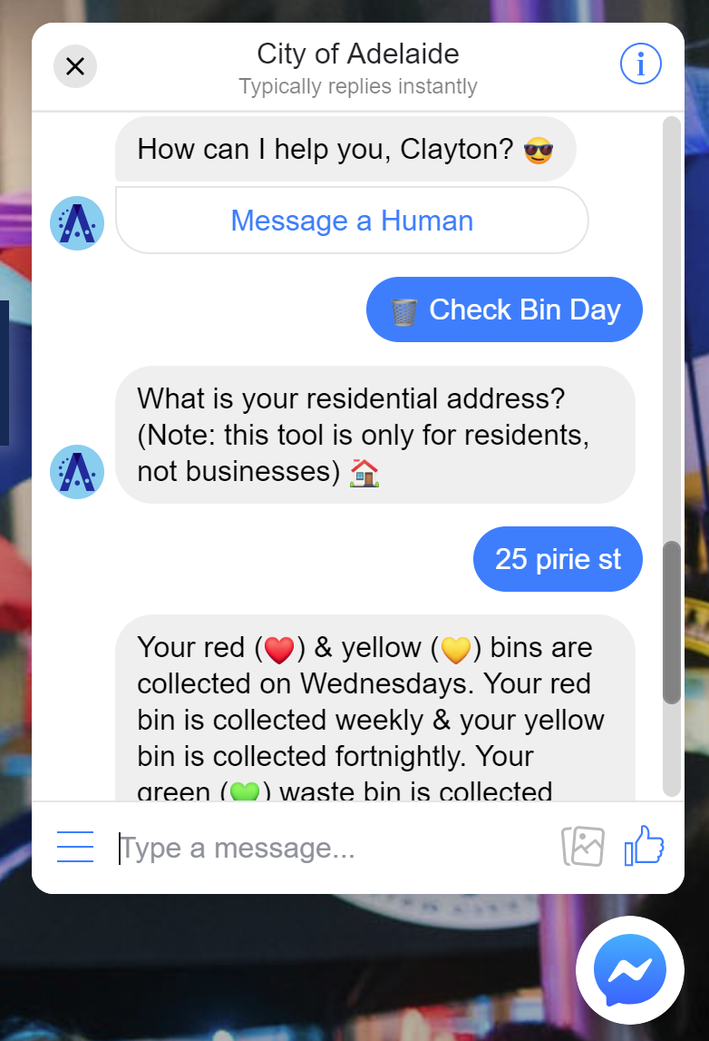
Text-based chatbots look like this…
Notes:
Text based chatbots look a little like this…I’ll show you more later in my live demonstration.

Slide 7
Who uses these messaging apps?
Did you know that messaging apps have surpassed social networks in terms of global usage?
Notes:
You will have noticed that chat clients and messaging apps are becoming very commonplace in society
Believe it or not, messaging apps have now surpassed social networks in terms of global usage.
People are now using the tools that you see on the screen for longer periods each day than Facebook, Instagram and Twitter.
Is anybody in the room using WhatsApp? Facebook Messenger?

Slide 8
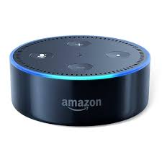
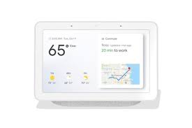
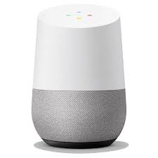
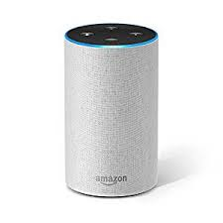
Who has one of these in their home?
Notes:
And it’s not just text-based messaging, increasingly it’s about voice…
Who has one of these in their home?
An Alexa or a Google Home?
Do you use Google Assistant, Siri or Cortana?
Anybody find them useful?
Do you think Google and Amazon are listening in to what you have to say?
‘OK Google, please record everything I say so that you can bombard me with highly targeted advertising’

Slide 9
Evolution of customer service and content delivery
Traditional
In-person
Telephone
Internet
Email
Web forms
Real-time…
Online chat
AI chatbots
Mail
Mobile apps
Social media
Fax
Automation
On-demand content
Print
Online content
Voice bots
Notes:
So what does the proliferation of chatbots and online messaging mean for organisations like ours?
Quite simply, it means that consumers are more inclined to use online messaging in their daily interactions with businesses and government entities.
According to Forrester Research, online messaging is ranked as the No.1 customer service channel preferred by consumers in South Korea, Singapore, India and the US, and among the top three preferred channels across the world.
What we’re seeing is the next major evolution in customer service
It used to be about in-person service, snail mail, the phone and fax
In the last decade or so, we’ve seen a clear transition to online contact methods - email, web forms, apps and social media
And now there’s a distinct shift to real-time methods – online chat, chatbots, automation and on-demand services.

Slide 10
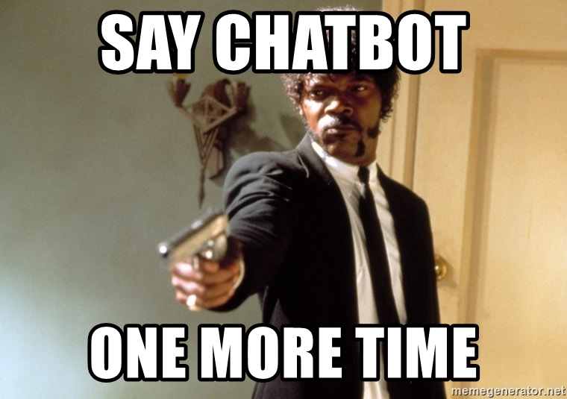
But don’t people hate talking to robots?
On the phone – yes.
But online, it’s more accepted.
One study found that 40 per cent of consumers don’t care whether a human or a chatbot responds to their questions as long as they get quick help.
Source: https://www.entrepreneur.com/article/321730
Notes:
But hang on, don’t people hate talking to robots?
On the phone - yes.
But online, it’s more accepted, particularly if you’re getting the answer you need immediately.
And just a note on the phones...telephones remain important for us Gen Xs and Baby Boomers, but how many 18 year olds actually use the phone function on their mobile phone?
All of their communication is done through social media and messaging. It takes far too long to actually call somebody up - that’s so 1990s, right?

Slide 11
Advantages of a chatbot
Round-the-clock service – 24/7, 365 days a year
Instantaneous response to the customer
Easy access for the customer via mobile phone
Routine enquiries can be handled quickly and easily
Internal resources used to respond to routine enquiries can be assigned to more complex duties
Potential long-term cost savings…touchy subject
Notes:
The advantages of chatbots for our organisations are fairly clear:
• 24/7, 365 days a year
• Instantaneous response to the customer
• Customers can access on their mobile phone
• Routine enquiries can be handled quickly and easily
• Staff who were previously responding to this routine enquiries can be assigned to more complex and more fulfilling duties
• Potential long-term cost savings…and this leads me to the change management requirements of heading down the chatbot path…

Slide 12
Change management
Inherent suspicion around this technology – am I going to be replaced by a bot??
New real-time customer service channel that is unfamiliar and daunting for some staff
Often not integrated with existing internal customer service systems
Concern that providing a chatbot will result in an unmanageable flood of enquiries
A challenge for change management…
Notes:
…particularly if you work in a bureaucratic government organisation like I do, there is:
Inherent suspicion around this technology – am I going to be replaced by a bot??
Chatbots represent a new, real-time customer service channel that is unfamiliar and daunting for some staff; not everyone’s adept at using chat
When you first adopt them, chatbots are often not integrated with existing internal customer service systems – handovers often need to be managed outside of their central system
Concern that providing a chatbot will result in an unmanageable flood of enquiries of unhappy people
So….
It’s important to take a softly, softly experimental approach to avoid treading on too many toes.

Slide 13
Fad or future?
Gartner research reveals that organisations report increased customer satisfaction and a reduction of up to 70% in call, chat and email enquiries after implementing a chatbot solution.
Gartner predicts that 25% of customer service and support operations will integrate virtual customer assistant or chatbot technology across engagement channels by 2020 – up from less than 2% in 2017
Notes:
Are chatbots are fad or are they the future?
Nobody knows for sure, but the indicators suggest that they’re here to stay
Organisations that are using them are reporting increased customer satisfaction and a reduction in enquiries through more traditional channels.
Gartner predicts that by next year - 2020 - a quarter of customer service organisations will be using chatbot technology, up from 2% in 2017

Slide 14
Example: Australian Open
In 2017 a bot created by the organisers of the Australian Open directly outperformed Ticketek in selling tickets for tournament.
The bot drove 170 per cent more conversions than Ticketek for a 25x return on investment.
Source: https://www.entrepreneur.com/article/321730
Notes:
Finally before talking more specifically about our own chatbot, I wanted to share a local example of a successful chatbot.
In 2017 a bot created by the organizers of the Australian Open directly outperformed Ticketek in selling tickets for tournament.
The bot drove 170 per cent more conversions than Ticketek for a 25x return on investment.
Are there repetitive processes is your organisation that you can you can automate like this?

Slide 15
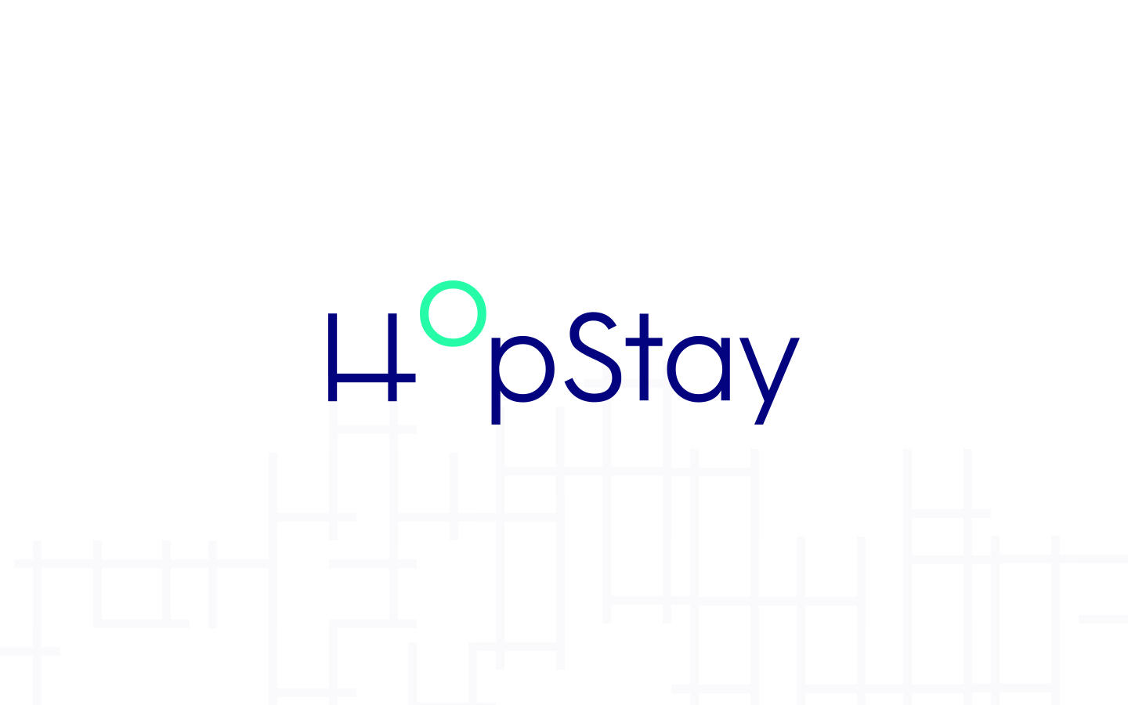
Notes:
So now it’s time to share our chatbot experience to date...
Our chatbot story begins back in June 2018 when we were approached by two young entrepreneurs from a small Adelaide startup company called Hopstay.
What was unique about Hopstay was the fact they had entered a startup competition run by the French Government, and they had been successful in winning a fully-funded, 3-year tenure in Paris to build their business.
At the time they approached us, we were undertaking a major redevelopment of the City of Adelaide website and thought that a chatbot might give the site some ‘wow’ factor when we launched, so we took the plunge and built an experimental chatbot.
The chatbot is equipped with a number of built-in content functions that I will show you shortly, and it can also respond directly to customer questions.
Whilst it can provide answers for just over 130 different customer service questions, it has the ability to handle over 35,000 different ‘utterances’ of those questions – the different ways that those questions are posed. And being an artificial intelligence engine, it learns with every new customer interaction.
Let’s take a look at the video…

Slide 16
Notes:
The chatbot uses Facebook Messenger and you can find it by searching City of Adelaide in the Messenger app on your phone, or it can be accessed via the blue button at the bottom right hand corner on our website. I hope you’ll give it a go!
It is by no means perfect. When you give it a shot, you’ll no doubt find a way to break it. We’re taking a ‘lean startup’ approach to the chatbot - that is, we’ve built it very quickly and we’ve exposed it to customer feedback as soon as possible. Our plan is to build, measure and learn, and to continually iterate on its capabilities. Over time, it will get better...
Has it been expensive? No, we’ve invested less than $10K so far.
Has it set the world on fire? I’ll be honest. It hasn’t. At least not yet. About 1,000 people have used the chatbot so far in eight months. But importantly there’s a growing number of people using it each month.
Have we encountered internal issues? Absolutely. I’m still working with our Customer Service Team to convince them that this is the way to go.
Finally it would be remiss of me not to mention the sponsor - Hootsuite Inbox is a fantastic interface for handling customer handovers from your chatbot. These can be routed to Hootsuite and chats can managed directly in the Hootsuite interface!
Ladies and gentlemen, thank you for having me.

